Slide 1
Florida Department of Health in Miami-Dade County
Maternal and Child Health Outcomes:
The Environmental Public Health Project
For the Community
Office of Community Health and Planning
Notes:
Welcome to the presentation on The Environment and Infant and Maternal Mortality for the Community.

Slide 2

What Will Be Covered
What is infant mortality & maternal mortality and why are they important?
What role does the environment play in our health?
Notes:
For this presentation we will answer two questions
define infant and maternal mortality, we will then go into their importance and why we should focus on them in our region along with he concerns we have as public health professionals. Next, we will highlight the environment’s role in health and the outcomes that come from it. Lastly, we will identify hot spots where environmental concerns overlap with the infant and maternal mortality rates in Miami-Dade County.
At the end of it all, we will review current and future initiatives to address the environmental concerns and mortality stats.

Slide 3
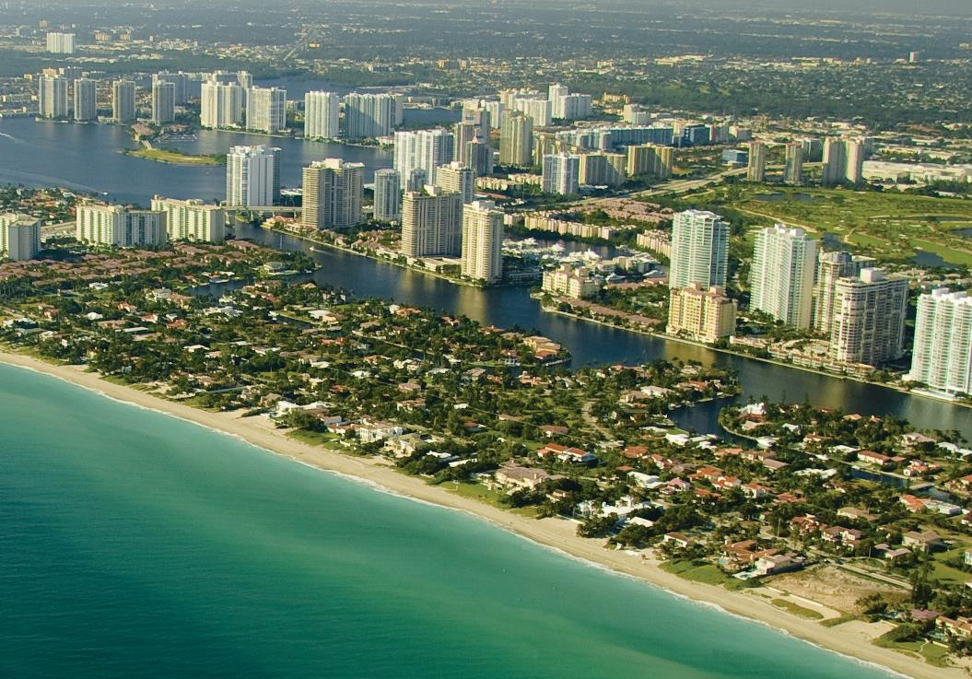
Miami-Dade County
2018 Population:
.
1
2,738,060
Notes:
First, let’s look at Miami-Dade county as a whole. Located in south Florida, Miami-Dade county has a population just over 2.7 million people. The region consists of 34 municipalities Miami, Homestead, and Florida City.

Slide 4
Demographics
Miami-Dade County
Race Data Miami-Dade County
1
Notes:
In terms of Demographics, Miami-Dade is about 78.8% White, 17.9 % Black or African American, with smaller populations of Asian, American Indian/Alaska Native, Hawaiian, and two or more races.

Slide 5
Demographics
Miami-Dade County
1
Hispanic Origin Data Miami-Dade County
Notes:
In terms of ethnicity, 69.1% of the county identifies as being of Hispanic or Latin origin, leaving just over 30% of the population identifying as not Hispanic or latinx.

Slide 6
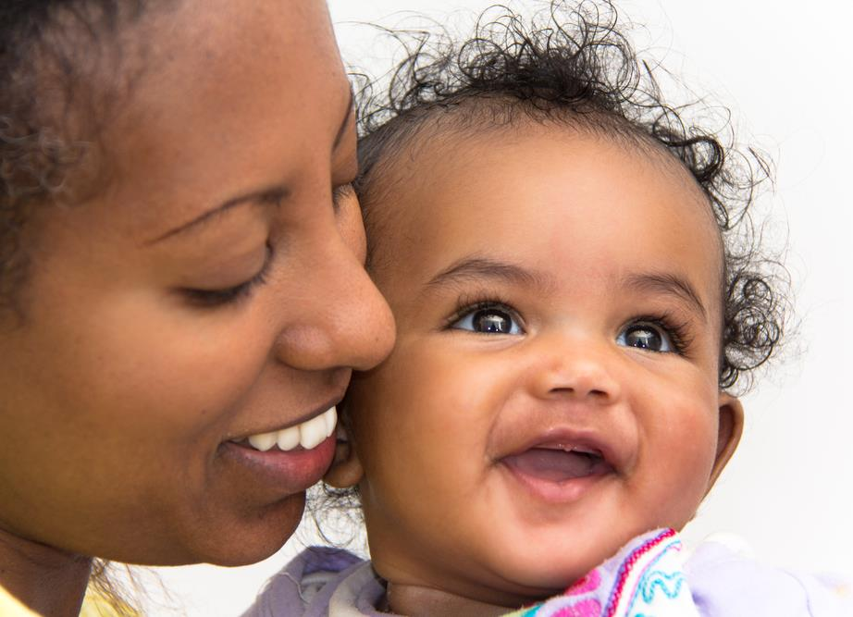
Infant and Maternal Mortality
In Miami-Dade County
Notes:
Now that we’ve looked at demographics, let’s look at infant and maternal mortality.

Slide 7
Infant Mortality
2
    Infant mortality is the death of an infant before their first birthday
Infant Mortality Rates per 1,000 Live Births, Miami-Dade & Florida:
    The infant mortality rate is an important marker of the overall health of a society.
Socioeconomic
Availability, access, and quality of care
Health equity
Notes:
What is infant mortality? It is the death of an infant before their first birthday. This is expressed by the number of infant deaths per 1,000 live births in a specific time period – the calculation is here at the bottom of this slide.
So why is this important? Infant mortality is an important marker of the overall health of a society, region, and/or community. It provides scientists and other public health professionals with a snapshot of health. We can look at things, such as income and education level, affordable and accessible health care and even health equity.
On the right of the slide are infant mortality rates per 1,000 live births in Miami-Dade. As you can see, our rates have been decreasing since 2017.

Slide 8







Disparities in infant mortality
3
White
Black
Hispanic
Non-Hispanic
3x
2x
 | Miami-Dade
 | White | Black
2018 | 3.1 | 10.8
2017 | 3.5 | 11.5
2016 | 3.1 | 13.0
2015 | 3.4 | 8.8
 | Miami-Dade
 | Hispanic | Non-Hispanic
2018 | 3.9 | 6.8
2017 | 4.3 | 6.2
2016 | 3.6 | 8.2
2015 | 3.7 | 6.2
Infant Mortality Rates per 1,000 Live Births
Infant Mortality Rates per 1,000 Live Births
Notes:
Moving forward, when we break down infant mortality by race we see huge differences in rates. Black populations within Miami-Dade and Florida are two to three times more likely to experience infant mortality compared to White populations.
Similarly, Non-Hispanic populations in Miami-Dade and Florida have higher infant mortality rates compared to Hispanic populations.
As you can see, this pattern hasn’t changed in previous years. In Miami-Dade, Black infant mortality spiked in 2016, but has been decreasing since. However, it’s still significantly higher than their White counterparts.

Slide 9

Causes Of Infant Mortality
Preterm Birth & Low Birth Weight
Birth Defects
Injuries
Sudden Infant Death Syndrome
Maternal Pregnancy Complications
Notes:
So what causes infant mortality in the first place? What factors should we be concerned about? According to the Centers for Disease Control and Prevention, the top 5 causes of infant death in 2017 were: Birth defects, preterm birth and low birth weight, maternal pregnancy complications, sudden infant death syndrome, and injuries.
Preterm birth & low birth weight, maternal pregnancy complications, and sudden infant death syndrome will be highlighted throughout the presentation.

Slide 10
Maternal Mortality
4
The death of a woman during pregnancy, at delivery, or soon after delivery.
5
Maternal Mortality Rates per 100,000 Live Births, Miami-Dade & Florida:
Maternal Mortality can be an indicator for population health and overall
quality of life.
Notes:
What is maternal mortality? It is the death of a woman during pregnancy, at delivery, or soon thereafter. It is expressed as the number of deaths divided by the total live births in the same period multiplied by 100,000 as seen on the slide.
Why is this important? Like infant mortality, it is an indicator for population health. However, it also is a great indicator for overall quality of life. For this we look at the built environment, access and quality of care, as well as socioeconomic factors.
On this slide, we see that Miami-Dade and Florida have similar rates. Miami-Dade, however, saw an increase in maternal deaths from 2017 to 2018.

Slide 11








Disparities In Maternal Mortality
5
White
Black
Hispanic
Non-Hispanic
4x
2x
 | Miami-Dade
 | Hispanic | Non-Hispanic
2018 | 10.7 | 19.4
2017 | 0.0 | 18.1
2016 | 5.0 | 34.7
2015 | 15.0 | 32.7
 | Miami-Dade
 | White | Black
2018 | 8.3 | 34.3
2017 | 0.0 | 31.6
2016 | 8.0 | 45.4
2015 | 16.2 | 29.3
Notes:
These rates, similar to those of infant mortality, differ greatly when broken down by race. Here you’ll find that Black populations are three to four times more likely to experience maternal deaths compared to White populations. As of 2018, the Miami-Dade County Black population had a maternal mortality rate of 34.3 deaths per 100,000 live births, while the White population had a rate of 8.3 deaths per 100,000 live births.
We see a similar pattern when comparing Hispanic and Non-Hispanic groups in Miami-Dade and Florida. While these rates have decreased among Non-Hispanic groups, they are still significantly higher than their Hispanic counterparts.

Slide 12

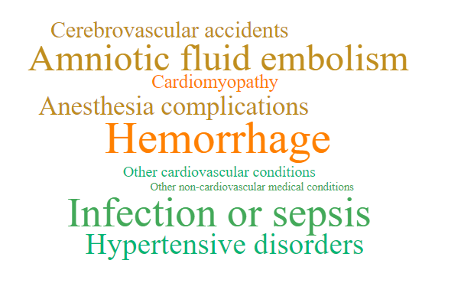
Causes of Maternal Mortality
4
Notes:
So what are the causes of Maternal Mortality? The top causes are hemorrhage, infection or sepsis, embolisms, and hypertensive disorders. A large percentage of maternal deaths are preventable, making this a great indicator for overall community health.

Slide 13

The Environment & Social Determinants
Data from the Environmental Public Health Tracking Project.
6
Notes:
For the last section of this PowerPoint we will look at the environment and social determinants, data is from the HCSF & FDOH Miami-Dade’s Environmental Public Health Tracking Project.

Slide 14






Pre-term Births
What are the health risks for babies who are born before 37 weeks?
What can cause pre-term birth?
Notes:
Before we highlight some of the social determinants, we want to take a quick look at preterm births as this indicator will be used for the next few slides.
Preterm births are defined as infants born before the 37th week of gestation. Babies who are born preterm have an increased risk for a variety of health concerns including death, long-term complications, and even Brain and nervous system developmental delays and conditions.
The top risk factors for pre-term birth leans heavily on the health of the mother. Which looks at her race, age, socioeconomic status, lifestyle, and even BMI.

Slide 15

Poverty Level
Poverty
Education
Health Outcomes
Occupation
Negative health outcomes may worsen depending on race, ethnicity, and/or age.
Notes:
The first determinant that we will look at is poverty level. For this, we will be looking at individuals who are living below the 100% marker level which equates to less than ~$12,490/year for a family of 1, or ~21,330 for a family of 3.
Why is poverty important? According to the U.S Department of Health and Human Services, there is a relationship between poverty and socioeconomic status and health outcomes – including premature death.
Unfortunately, these health outcomes may be worse depending on your race or ethnicity, as we’ve seen in previous slides with infant and maternal mortality, and it may be worse with age. There are conditions, like dental cavities, that affect children in poverty more than adults in poverty.

Slide 16

Map #1: Poverty Level
Communities with higher rates of poverty and pre-term birth
33157 (West Perrine/Cutler Bay
33039(Homestead)
33032(Princeton/Naranja)
33033(Homestead)
This Photo by Unknown Author is licensed under CC BY-ND
Notes:
The maps over the next few slides are from the Health Council of South Florida. On this slide, you’ll find a map related to poverty level. We wanted to determine if there is an association between preterm births and poverty level Miami-Dade. In this map we see that 33039(Homestead), 33032(Princeton/Naranja), and 33033(Homestead) have preterm births rates that are double that of Miami-Dade county and Florida. We also find in this region high percentages of the population living below the poverty line. Even more Interesting, we find that West Perrine/Cutler Bay has about 22% of their live births registered as pre-term, but only 7% of its population living below the poverty level, which is a rate lower than MDC and Florida.

Slide 17
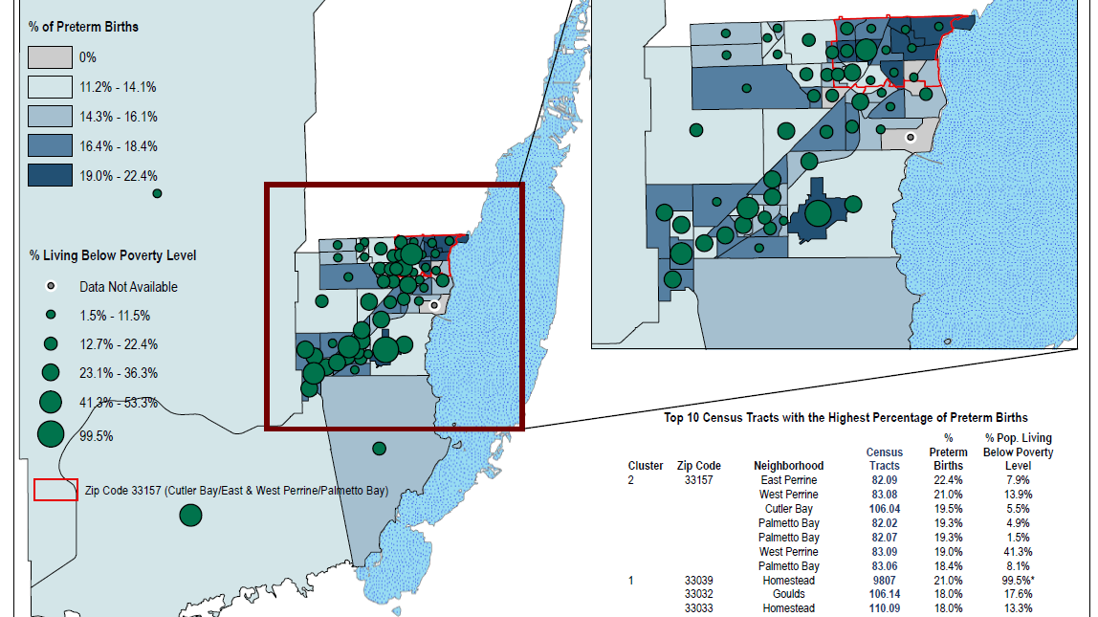
Notes:
Here is a close-up image of the map that overlaps poverty level and preterm births.

Slide 18


Air Quality - Health Outcomes
Air pollution is linked to post-neonatal deaths (death that occur between 28 days of life and one year).
This includes Sudden Infant Death Syndrome (SIDS).
7
Pollution can come in different sizes! Large particles can cause eye and throat irritation
Notes:
Next we will look at Air quality.
Pollution, is associated with post-neonatal deaths– which occurs between 28 days of life and the first birthday. Pollution is also linked to Sudden Infant Death Syndrome, which is one of the leading causes of infant mortality. Pollution particles come in a variety of sizes. The large particles, which includes matter like dust, can cause eye, throat, and lung irritation.
Q: What other conditions do you think can either be caused by or exacerbated due to poor air quality?
A:
- Asthma
-Heart Disease
- COPD
- Multiple forms of cancer
https://ephtracking.cdc.gov/showRbInfantMortalityEnv.action

Slide 19





Air Quality – Health Outcomes
Wood stoves
Forest fires
Powerplants
Factories
Motor vehicles
Small particles of pollution can enter your lungs and even your bloodstream!
Gases released from industrial sites and motor vehicles contain very small particles of pollution
Notes:
What about pollution particles that are very small? These can enter into very deep areas of your lungs and can also enter your bloodstream. Because of this, they can cause serious health outcomes especially among the most vulnerable and those who have been exposed over long periods of time. As you can see from the slide, powerplants, factories, and cars are well known for releasing these particles into the air.
https://www.cdc.gov/air/particulate_matter.html

Slide 20

Map #2: Proximity To Roadway
Communities with high rates of Preterm Births and life within 500 Feet of a Congested Roadway
33157 (West Perrine/Cutler Bay
33039(Homestead)
33032(Princeton/Naranja)
33033(Homestead)
Notes:
Now that we’ve looked at emissions and how vehicles contribute, let’s look at roadways with large amounts of traffic that are within the same vicinity of neighborhoods.
Q: Why would we want to look at this?
A: Overall air quality for communities
- Elongated exposure can be of huge concern meaning local populations may have higher rates of certain health conditions.
Research done by HCSF found that the zipcodes on the slide have preterm birth rates that are higher than the county AND the state. For instance the zipcode 33033 in Homestead had 18% of their live births registered as preterm. In this same zip code, 31% or close to one-third of the community lives within 500 ft of a congested roadway.

Slide 21
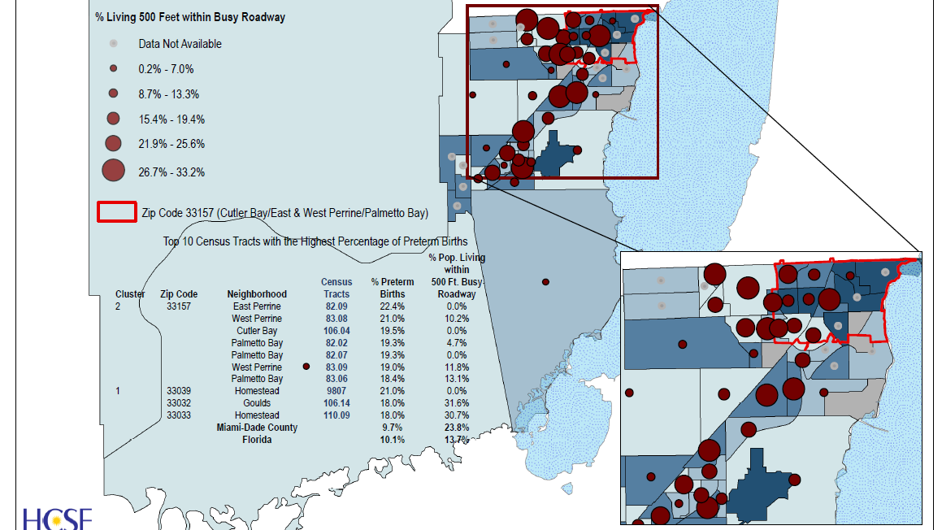
Notes:
Here is a larger image. As you can see, West Perrine/Cutler Bay, Homestead, and Princeton/Naranja are at the top of this list.

Slide 22


Health Insurance
Stable health insurance coverage
Better health
Lower chance of pre-mature death
12
As of 2018:
40.8 %
8
of Births in Miami-Dade are paid for by Medicaid
of births were self-Pay
(0.8% White, 2.1% Black) of births with known prenatal care status did not receive any prenatal care.
Of pregnant mothers visited their doctor regularly during their pregnancy
10.2 %
9
1 %
10
79.5 %
11
Notes:
Lastly, we will look at health insurance which has been a hot topic in the U.S for several years due to its public health implications. This excerpt taken from the Institute of Medicine’s Committee on the Consequences of Un-insurance states “…if adults who now lack health insurance were to be insured on a stable and ongoing basis, their health status would likely be better than it would be without health insurance, and their risk of dying prematurely would be reduced.”
Q: Can anyone give a short summary of what they are trying to explain in this excerpt?
A: That the lack of insurance factors into one’s health.
Q: What role do you think insurance plays in health? What if someone doesn’t have insurance?
A: Lack of insurance means less doctor’s visits, less continuation of care, less likely to address acute and chronic symptoms.
As of 2018, 40.8% of births in Miami-Dade were covered by Medicaid and 10% of the births in the region were self-pay. 1% of all births with known prenatal care status didn’t receive any prenatal care. When broken down by race, we find that 0.8 % of White mothers didn’t receive any care compared to 2.1% of Black or African American Mothers.
Lastly, we see that 79% of pregnant mothers visited their doctor on a regular basis during their pregnancy. This is important as it gives professionals a snapshot of health care utilization in Miami-Dade.
*More in depth definition from FLHealthCharts:

Slide 23
Percentage Of Insured by Race & Ethnicity, Miami-Dade 2018
13
WHITE, ALONE
BLACK OR AFRICAN AMERICAN
ASIAN, ALONE
84.5 %
79.8 %
87.9 %
OTHER RACE
TWO OR MORE RACES
LATINO OR HISPANIC
77.6 %
89.1 %
82.6 %
Notes:
How does insurance coverage look when broken down by race and ethnicity? As you can see there is a slight variation between race and ethnicity in terms of insurance coverage.
https://data.census.gov/cedsci/table?q=miami%20dade%20county%20insurance&g=0500000US12086&tid=ACSST1Y2018.S2701&layer=VT_2018_050_00_PY_D1&vintage=2018&hidePreview=false

Slide 24

Map #3: Health Insurance
Communities with high Infant Mortality Rates and high rates of un-insured residents.
33157 (West Perrine/Cutler Bay)
33032(Princeton/Naranja)
33033(Homestead)
33039(Homestead)
33030 (Homestead)
33031 (Redland)
33034 (Florida City)
33170 (Goulds/Princeton)
Notes:
Instead of looking at pre-term birth, we are focusing on infant mortality in general and if health insurance is associated with its rates. Compared to the previous slides, there are more zipcodes or areas of concern. Miami-Dade County has an infant mortality of 4.9% and an uninsured rate of 18.1. All zipcodes listed exceed both of these rates. West Perrine and Cutler Bay has an infant mortality rate of 17.2%, almost 4 times more than MDC, and an uninsurance rate of 19.7.

Slide 25
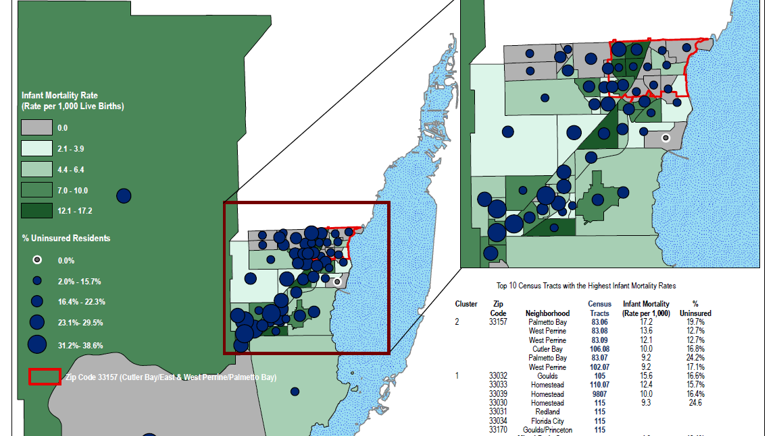
Notes:
Here is a zoom in photo of the map.

Slide 26
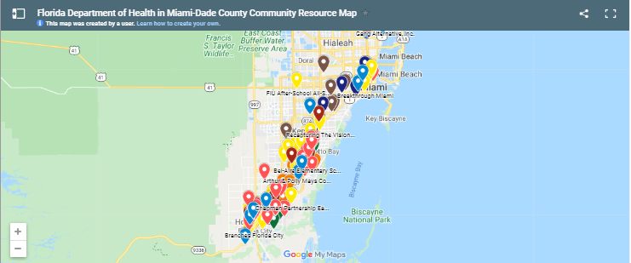
Resources For The Community
HealthyMiamiDade.Org
Visit the website to find resources and services near you
Notes:
Need information on local resources and services? The Consortium for a Healthier Miami Dade’s website has a map that’s easy to use with all of the following information:
Behavioral health resources
Community based services
Daycare
Disability resources
Domestic Violence Resources
Educational Programs
Faith Based Organizations
Health Programs
Parent and Family Support.

Slide 27
References
United States Census Bureau (n.d) https://www.census.gov/quickfacts/fact/table/miamidadecountyflorida/POP060210
Centers for Disease Control and Prevention. (2019). Infant Mortality. https://www.cdc.gov/reproductivehealth/maternalinfanthealth/infantmortality.htm
Florida Department of Health, Division of Public Health Statistics & Performance Management. (2020) Infant Deaths. http://www.flhealthcharts.com/charts/DataViewer/InfantDeathViewer/InfantDeathViewer.aspx?indNumber=0053
Centers for Disease Control and Prevention. (2020). Pregnancy Mortality Surveillance System. https://www.cdc.gov/reproductivehealth/maternal-mortality/pregnancy-mortality-surveillance-system.htm
Florida Department of Health, Division of Public Health Statistics & Performance Management. (2020). Maternal Deaths. http://www.flhealthcharts.com/charts/DataViewer/InfantDeathViewer/InfantDeathViewer.aspx?indNumber=0392

Slide 28
References
Health Council of South Florida, Inc. & Florida Department of Health in Miami-Dade County (2020). Environmental public health tracking project.
Centers for Disease Control and Prevention. (2016). National environmental public health tracking: reproductive and birth outcomes. https://ephtracking.cdc.gov/showRbInfantMortalityEnv.action
Florida Department of Health, Division of Public Health Statistics & Performance Management. (2020). Births covered by Medicaid. http://www.flhealthcharts.com/charts/DataViewer/BirthViewer/BirthViewer.aspx?cid=0595
Florida Department of Health, Division of Public Health Statistics & Performance Management. (2020). Births with self-pay for delivery payment source. http://www.flhealthcharts.com/charts/LoadPage.aspx?l=~/DataViewer/BirthViewer/BirthViewer.aspx?cid=0617
Florida Department of Health, Division of Public Health Statistics & Performance Management. (2020). Births to mothers with no prenatal care. http://www.flhealthcharts.com/charts/DataViewer/BirthViewer/BirthViewer.aspx?cid=0016

Slide 29
References
Florida Department of Health, Division of Public Health Statistics & Performance Management. (2020). Births with Adequate Prenatal Care (Kotelchuck index). http://www.flhealthcharts.com/charts/DataViewer/BirthViewer/BirthViewer.aspx?cid=0615
Institute of Medicine- Committee on the Consequences of Uninsurance. (2002). National Academies Press: Washington DC. https://www.ncbi.nlm.nih.gov/books/NBK220633/
United States Census Bureau. (n.d). Selected characteristics of health insurance coverage in the united states https://data.census.gov/cedsci/table?q=miami%20dade%20county%20insurance&g=0500000US12086&tid=ACSST1Y2018.S2701&layer=VT_2018_050_00_PY_D1&vintage=2018&hidePreview=false

Slide 30
Thank You

